Slide 1

DanceStudio
171290107024 (IDP)
BE Semester : 8th Computer
Team ID : 125092
Faculty Guide : Prof. Umesh Lakhtariya
Academic Year
(2020-2021)

Slide 2
OUTLINE
Introduction
Project Development Approach
Project Scheduling
User Classes
System Design
Screen Shots
MODULE SPECIFICATION
Conclusion and Discussion

Slide 3
INTRODUCTION
ABSTRACT
My project is about Dance Studio. Providing premium features like people can interact with trainer to learn dance for wedding, reception, events, some festival.
Further user can learn types of dance like rumba, waltz, night club, party dance.
Depends on their premium account they will access more resources with more functionality.
Additionally people can make dance videos offline so can access without any internet connection.

Slide 4
INTRODUCTION
CURRENT PROBLEMS
Following are current issues world are faces:-
User don’t have standard online platform to learn all types of dances with the premium account.
User don’t have online functionality like provide seamless video experience and user can offline video when they are use wifi.

Slide 5
INTRODUCTION
User don’t have application which is User friendly so user can enjoy while used online platform.
User can’t learn from specialized trainer.

Slide 6
INTRODUCTION
SOLUTIONS
Using this Android Application, users can learn All types of dance like waltz, rumba, night club, foxtrot, tricks and user can learn dance for specific events like wedding, reception, party.
User can use trending online functionality like enjoy seamless video experience with premium account and user can make video offline and access video without any internet connection.

Slide 7
INTRODUCTION
User can also add to list video, watch later video watch video category wise.
Trainer also get advantage to this application. They can make video and put on this application and earn money.
Provide High security so user cannot access video without any premium account and other user can’t use this application if they don’t have premium account. If one have account with 4 user so only 4 user can access videos and can enjoy, other cannot use that account.

Slide 8
PROJECT DEVELOPMENT APPROACH
After understanding the objectives, we decided to use the iterative model for the development of our application. The project has many functionality and modules that can’t be fulfilled in one go so, we have decided to use this model. So, that we can evaluate the project after some amount of time and can work on that if needed or we can move to another functionality.

Slide 9
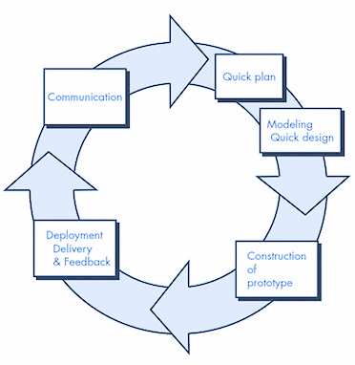
PROJECT DEVELOPMENT APPROACH

Slide 10
PROJECT SCHEDULING
 | Expected Day | Actual Day
Analysis | 30 | 30
Design | 30 | 30
Coding | 60 | 70
Testing | 10 | 10

Slide 11
USER CLASSES
1. Admin
• Admin handles all activity of users.
• Admin handles following
➢ Verify Users
➢ Reject Users
➢ Add Dance Videos
➢ Remove Dance Videos
➢ Insert, Update, Delete Premium Users

Slide 12
USER CLASSES
2. User
• User uses this online platform.
• If User have premium then and then he/she can watch video.
• User do’s as following
➢ Add account for premium
➢ See video as per desired

Slide 13
USER CLASSES
➢ Like videos
➢ Download Videos offline
➢ Add videos to list
➢ Watch later videos
➢ Add videos to favourites
➢ Provide feedback of application

Slide 14
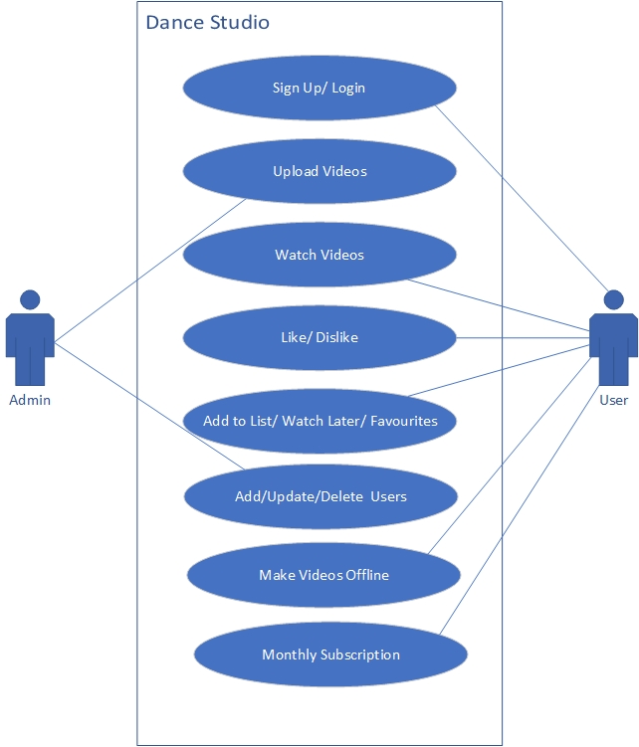
SYSTEM DESIGN
Use Case

Slide 15
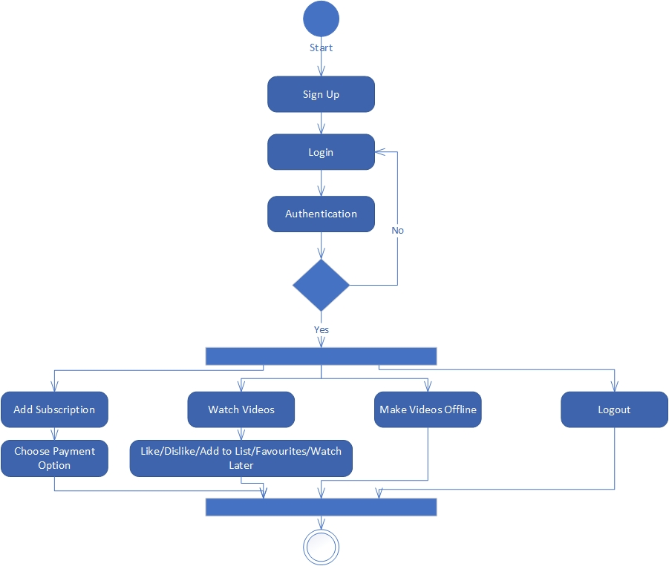
SYSTEM DESIGN
Activity

Slide 16
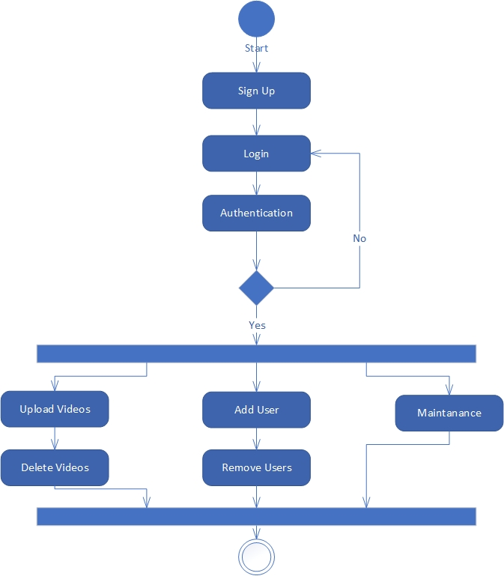
SYSTEM DESIGN
Activity

Slide 17
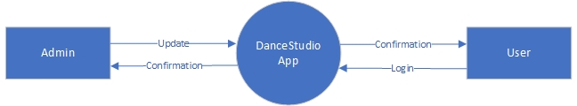
SYSTEM DESIGN
DFD level 0

Slide 18
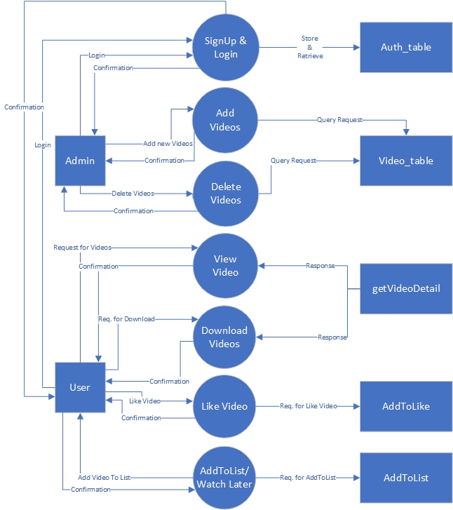
SYSTEM DESIGN
DFD level 1

Slide 19
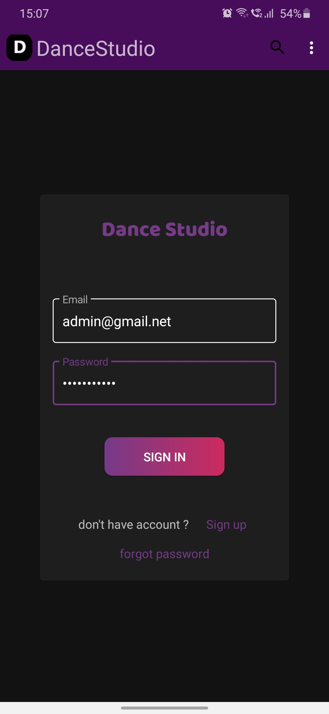
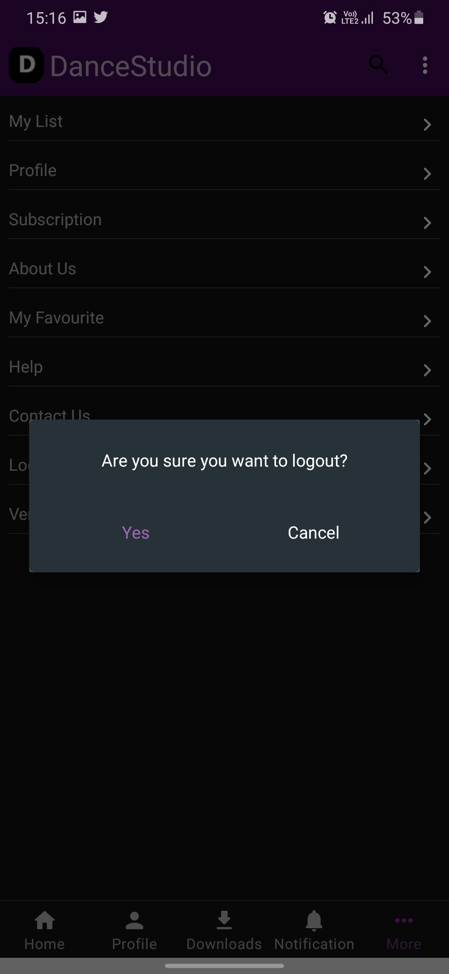
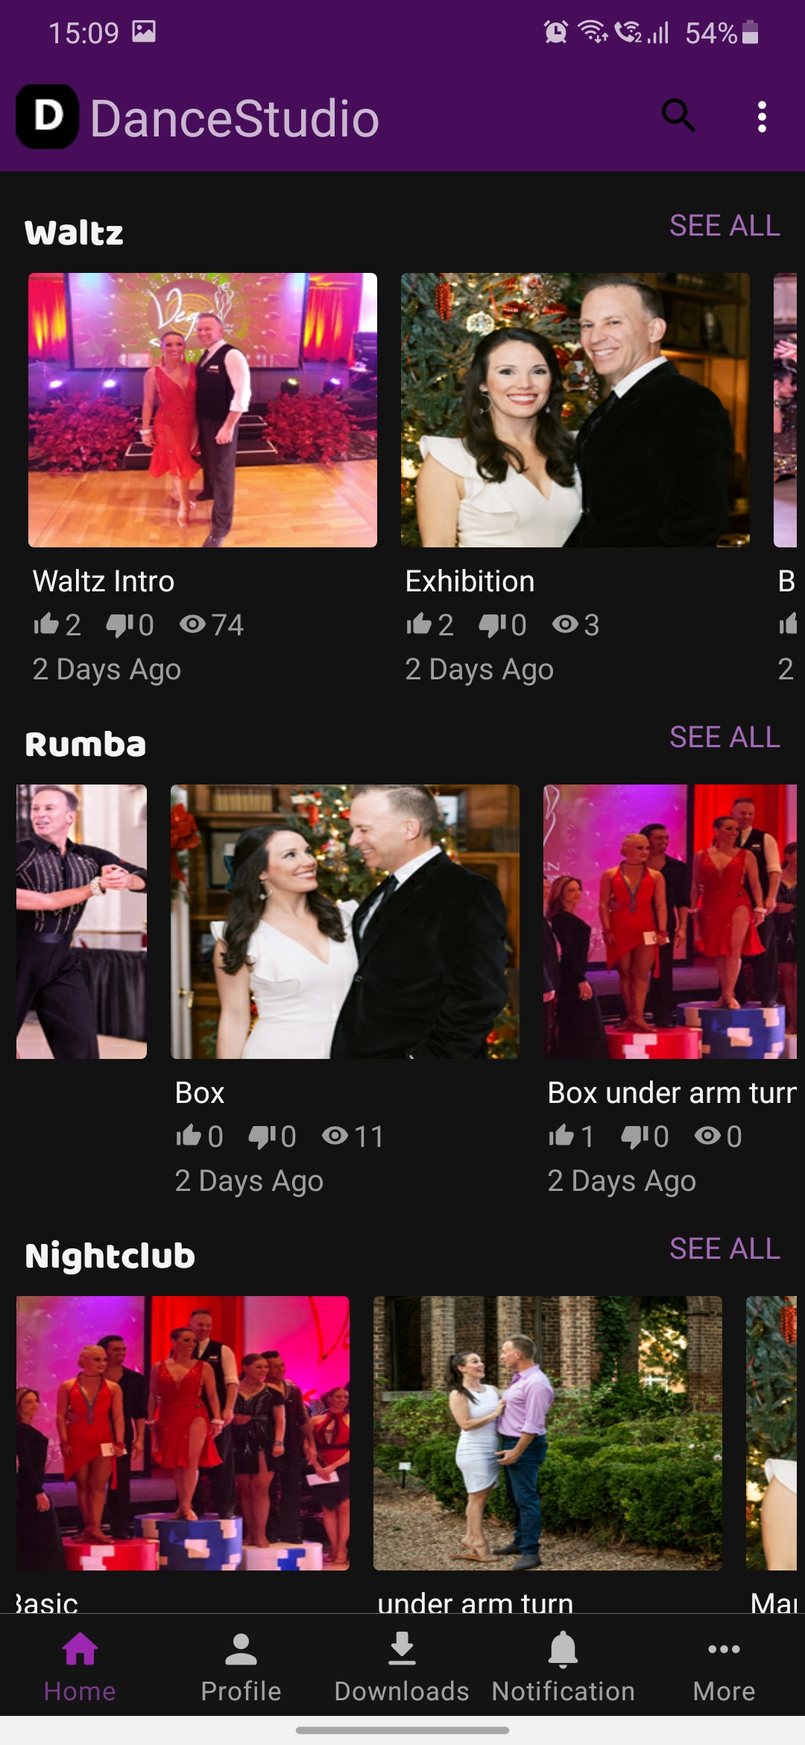
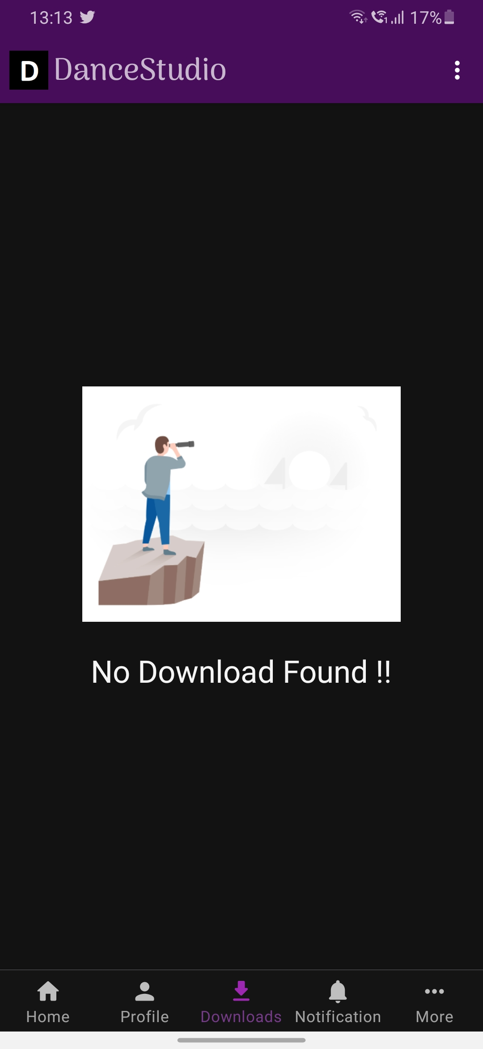
SCREENSHOTS

Slide 20
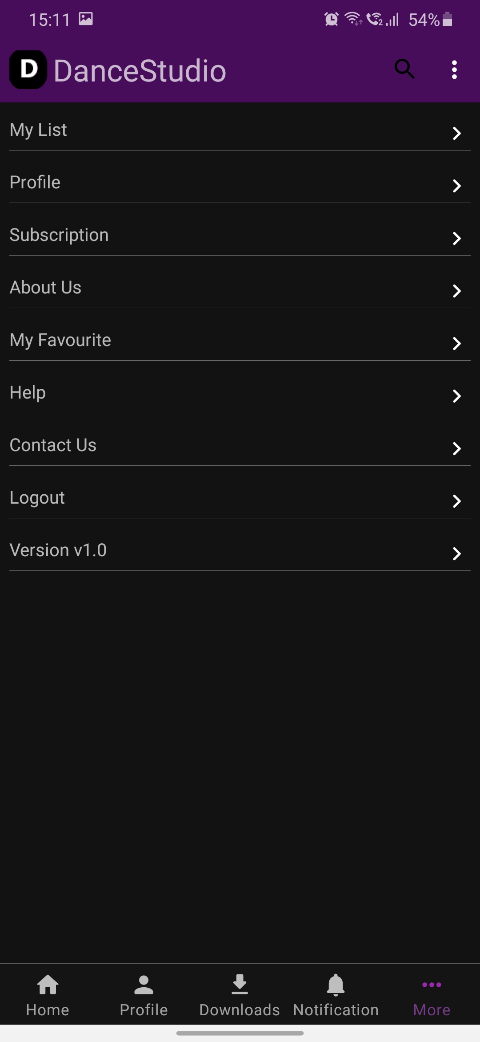
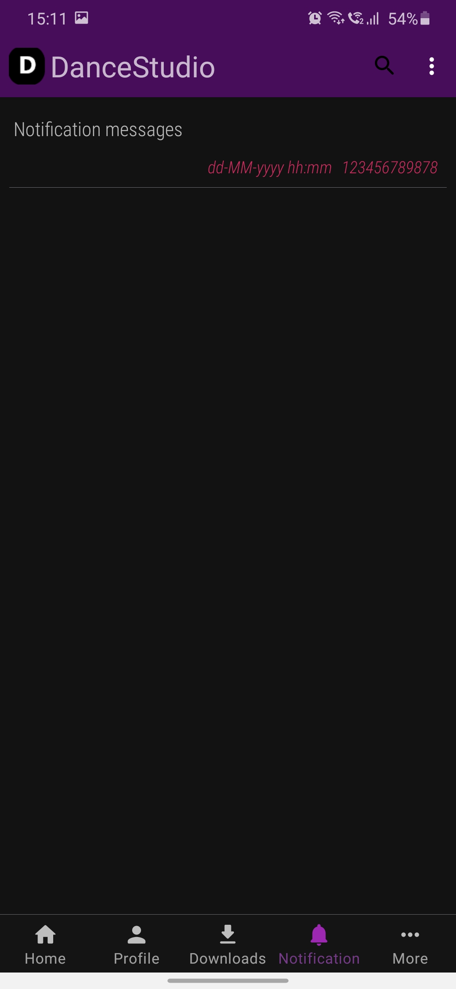
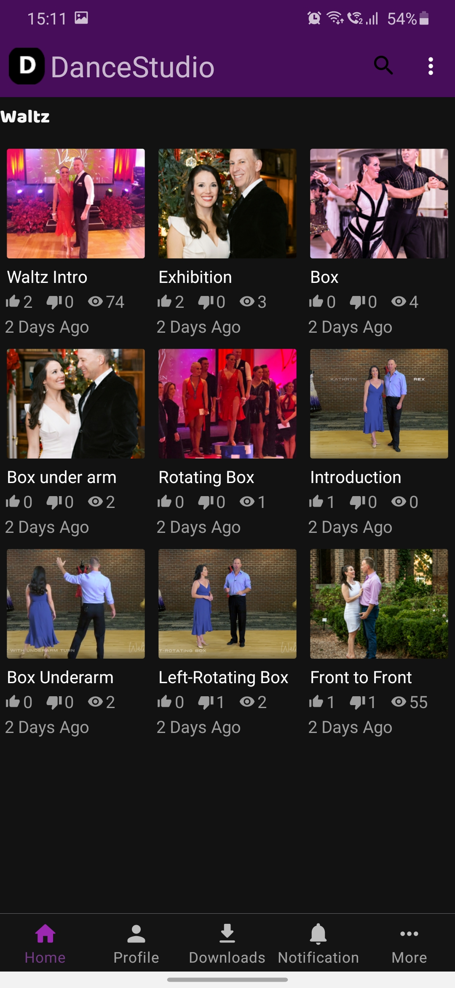
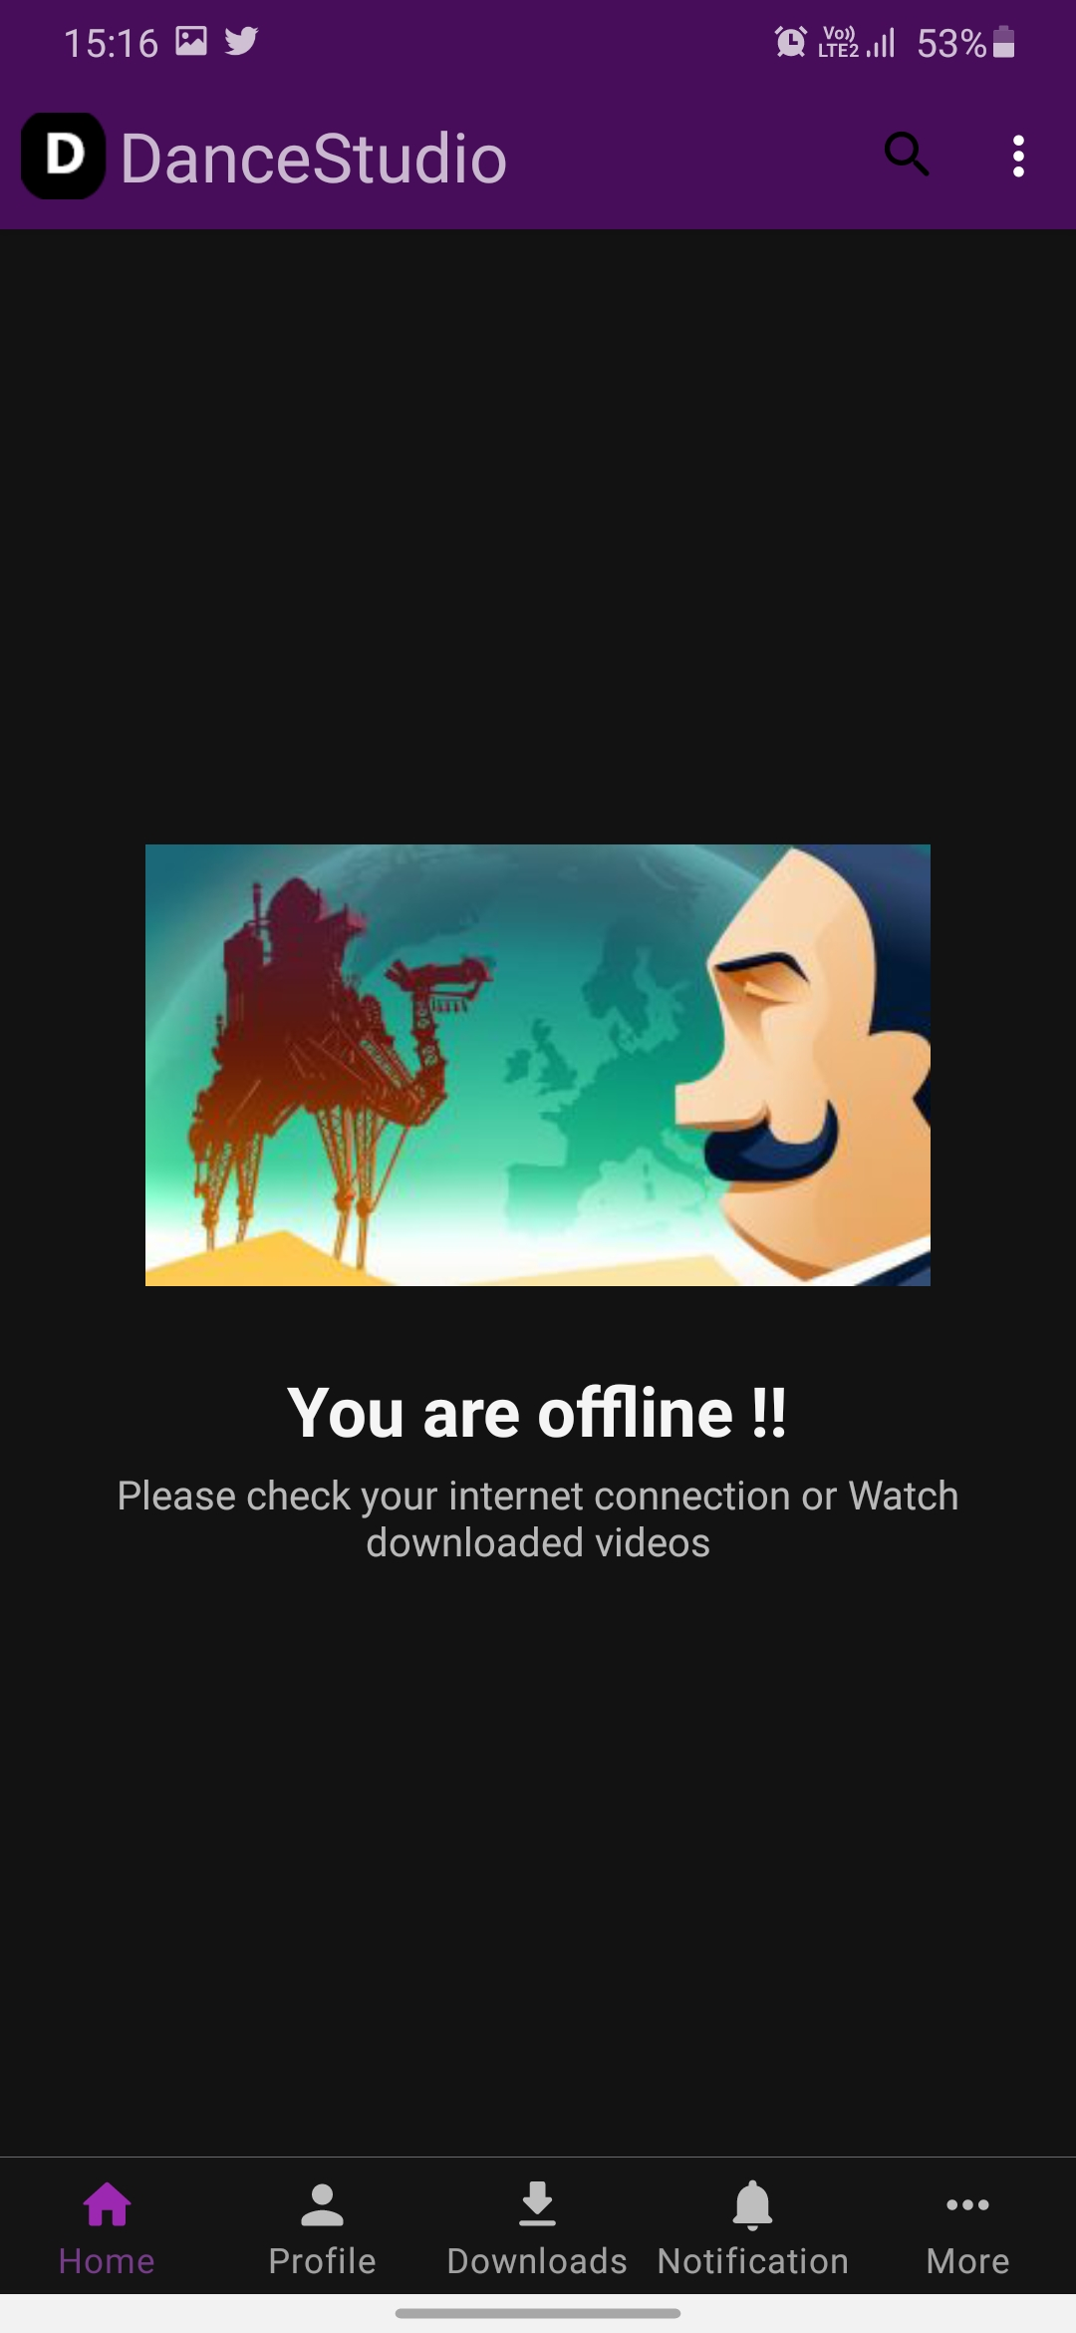
SCREENSHOTS

Slide 21
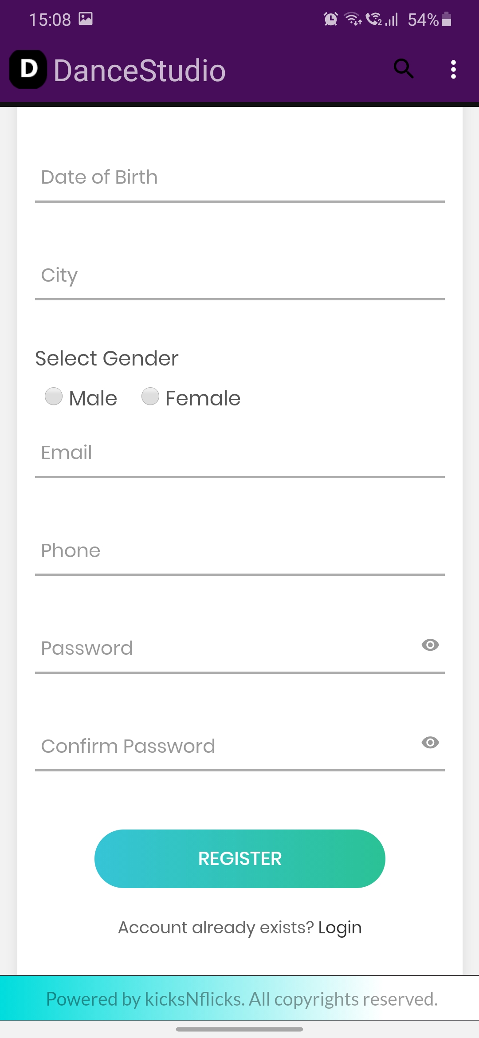
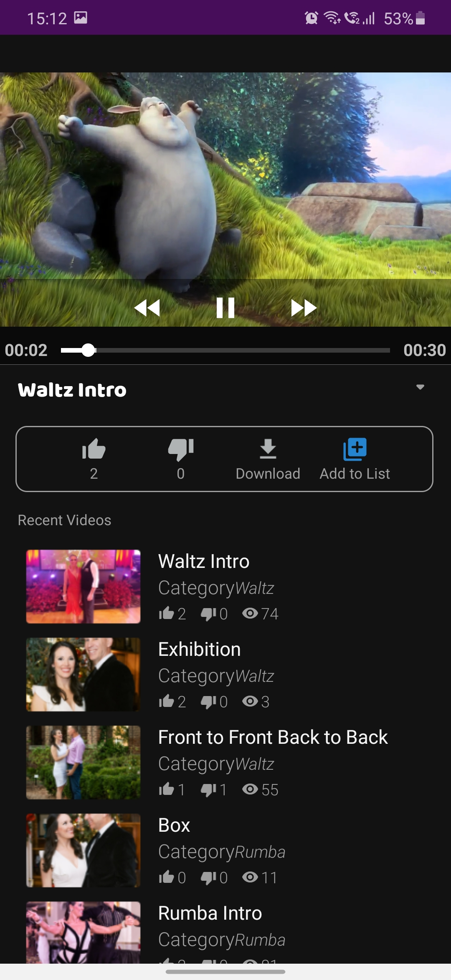
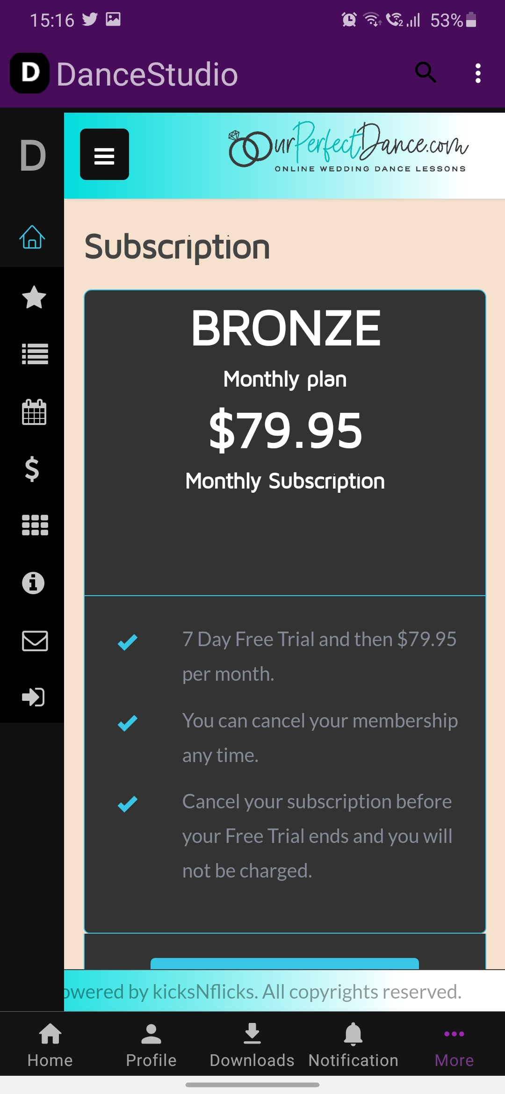
SCREENSHOTS

Slide 22
MODULE SPECIFICATION
We introduce one android application for those who have to learn dance at home and for those who are interested to train people for dance. Our application is a platform for learning various types of dance like waltz, rumba, night club, party etc.
Trainees will post their video through our application and they will earn money depending on their performance and according to various criteria.

Slide 23
MODULE SPECIFICATION
User will get a subscription and watch videos related to his paid subscription and learn dance and they can like videos, dislike, add to list, watch later, offline videos and many more.
This application is fully secured and the user would have end to end encryption and the user cannot play video in other 3rd party applications like MX player, VLC player or other else.

Slide 24
CONCLUSION AND DISCUSSION
Problem :
When we started designing an application we faced the design issue like layout should be proper in every page and main problem we faced is layout should be the same in each size of screen whether small or large android device.

Slide 25
CONCLUSION AND DISCUSSION
Solution :
Solution for above mentioned problem we give a weight sum that equally divides the layout and layout should not change with the screen size.

Slide 26
THANK YOU

